Slide 1



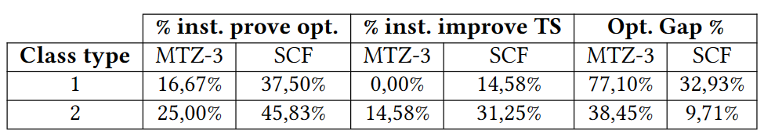
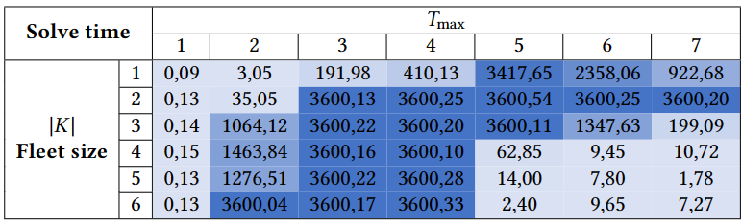
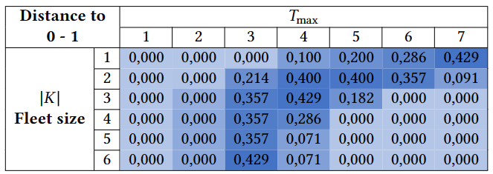
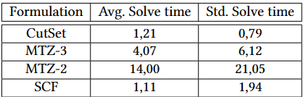
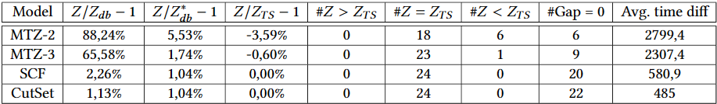
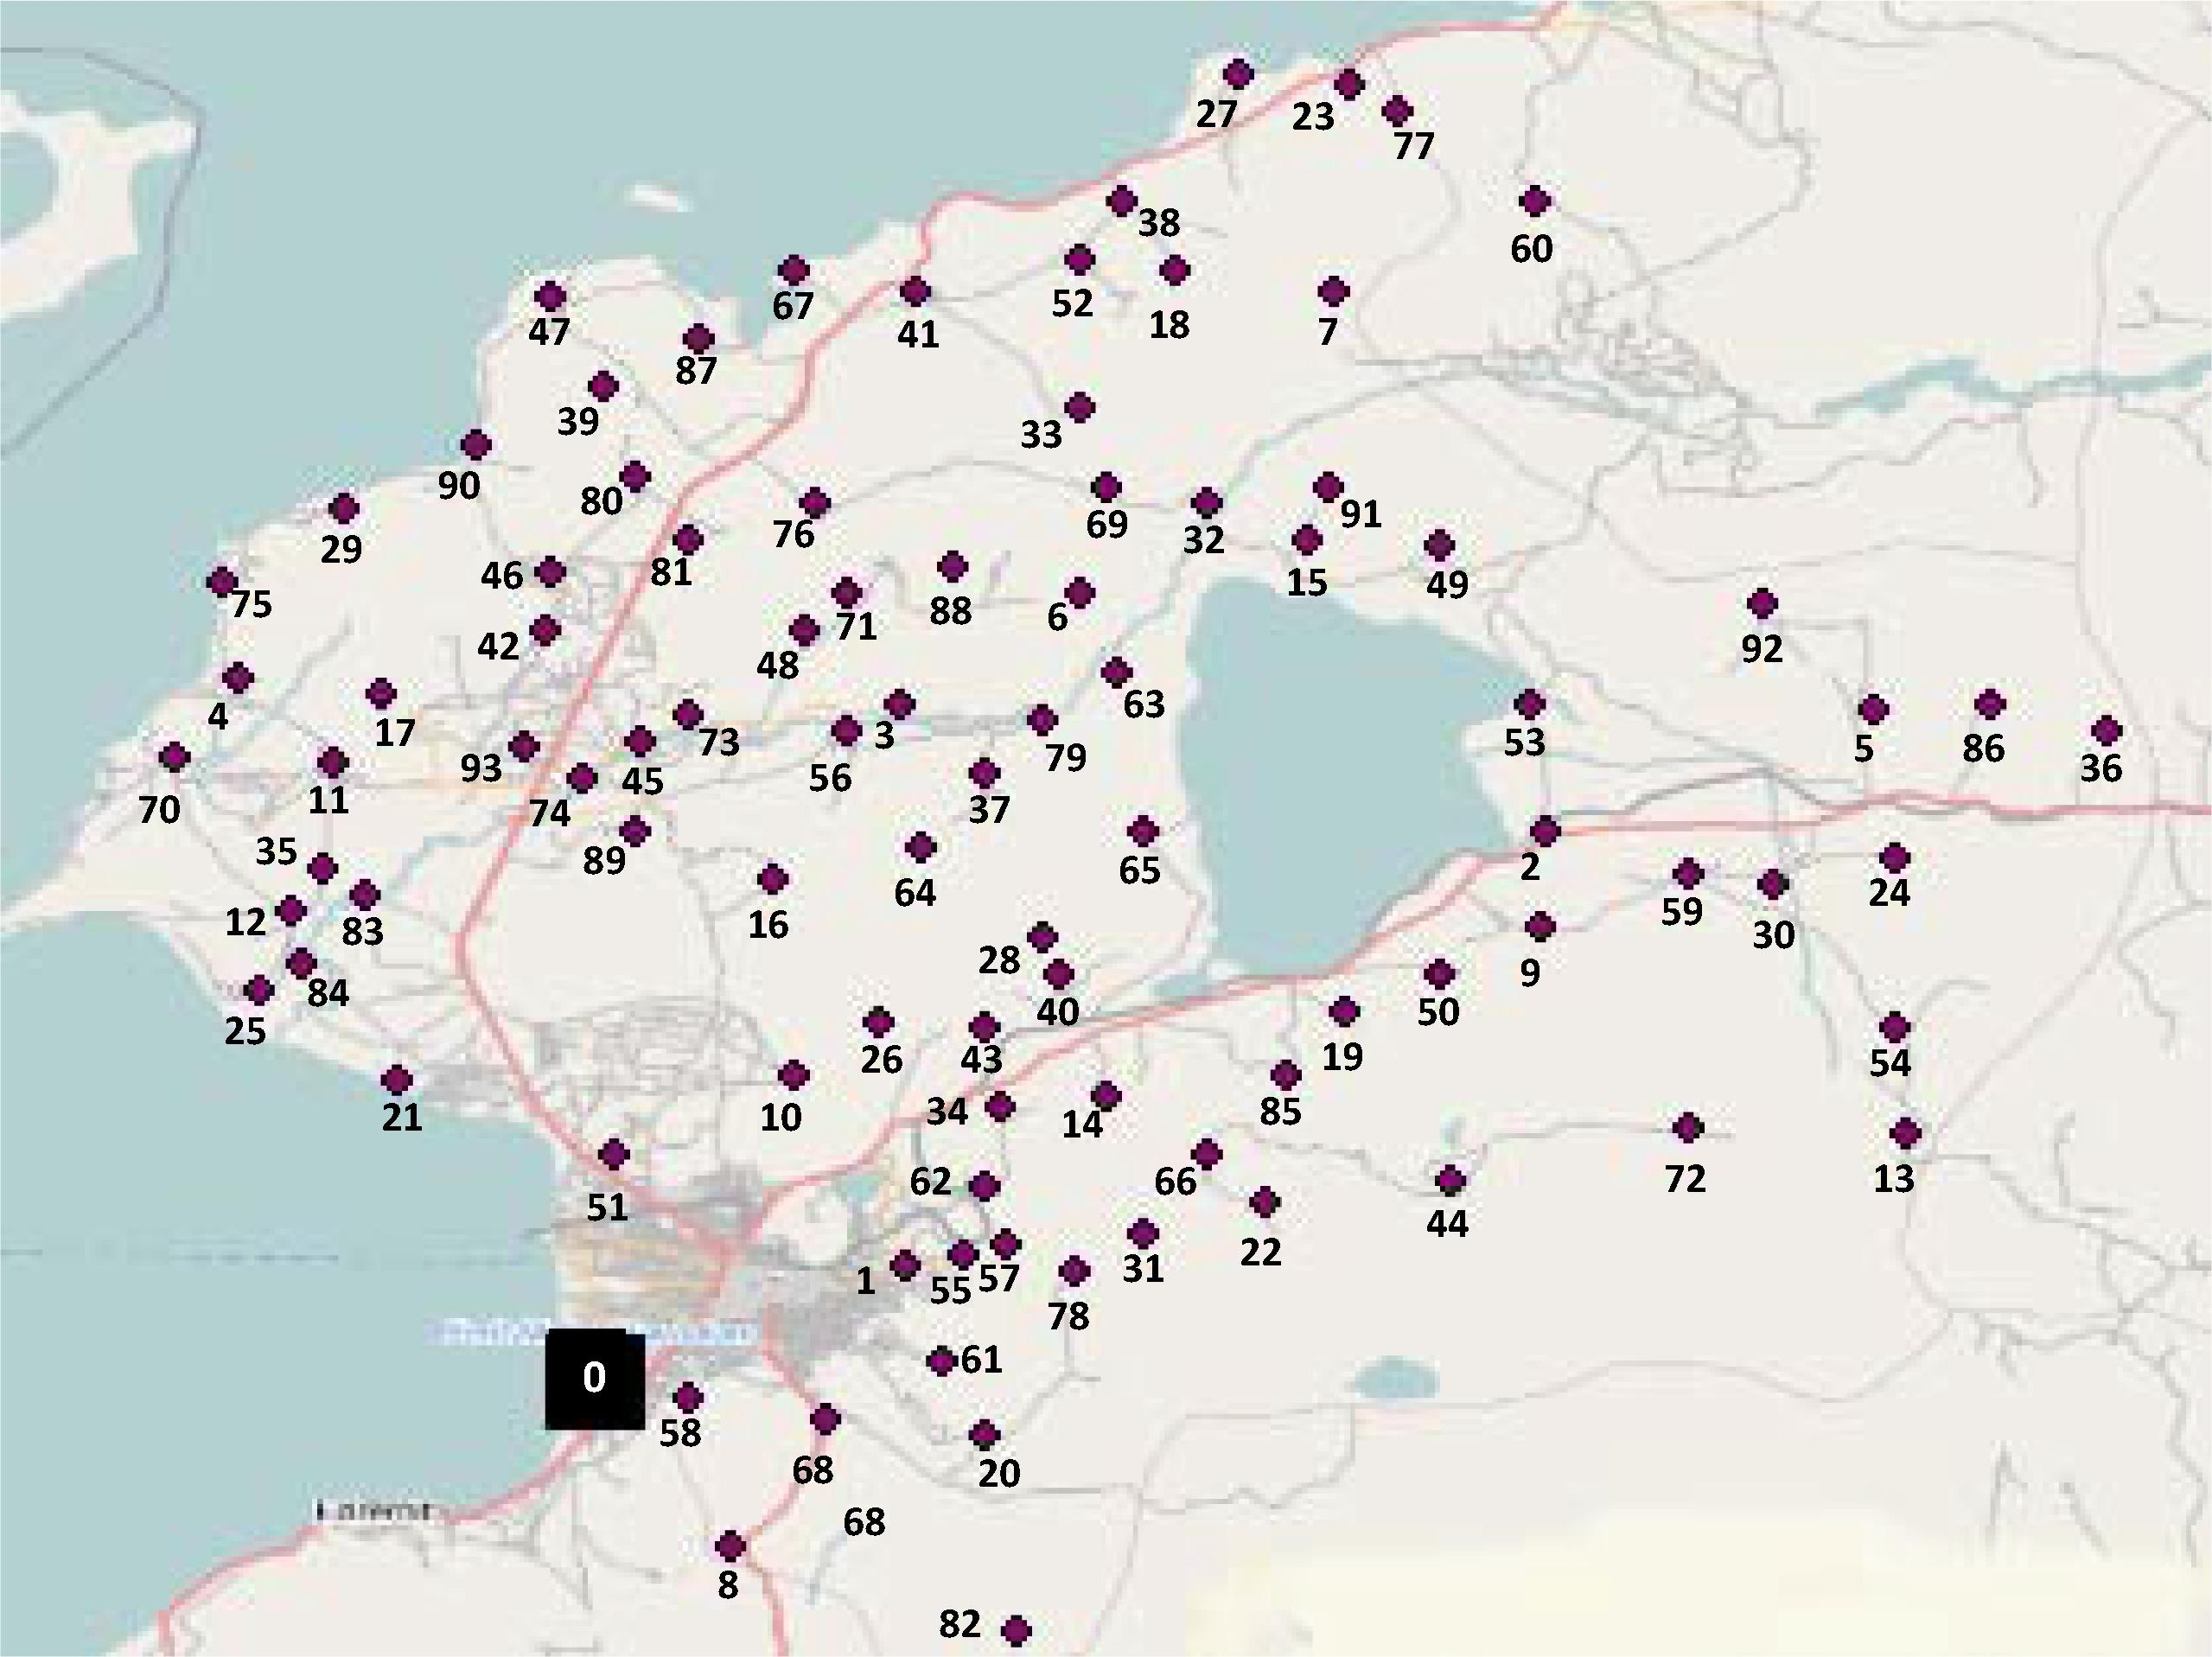
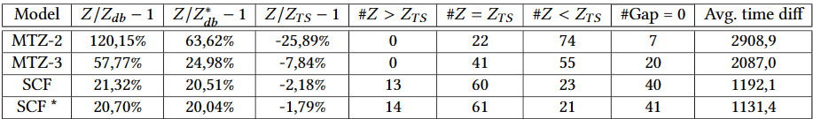
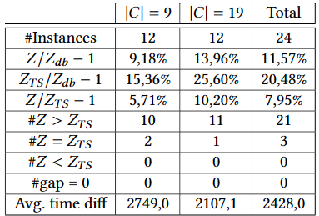

Exact methods for the Selective Assessment Routing Problem
Project in collaboration with:
Institute for Transport and Logistics (WU Vienna)
Main supervisor: Vera C. Hemmelmayr, Ao. Univ. Prof. (WU Vienna)
Cosupervisor: Günther Raidl, Ao. Univ. Prof (TU Wien)
Joan Salvà Soler
M.Sc. Data Science
Interdisciplinary Project - 194.147
The real-world problem
The optimization problem
Once a disaster occurs, humanitarian agencies carry out rapid assessments of the affected region. Since rapid needs assessment stage must be completed quickly, assessment teams do not make observations at all the affected sites; therefore, sites to be visited are sampled. As opposed to random sampling, purposive sampling tries to visit a set of sites that are representative for the
whole region.
To do that, the following steps are followed: 1) critical characteristics are specified (e.g. topography, altitude, age, gender, economic activity…), 2) sites to visit are selected making sure that all characteristics are partially covered, and 3) the logistical plan assigns sites to vehicles, and the routes to cover the sites of each team.
Operations Research plays an important role in Humanitarian Logistics. In particular, the solution of an optimization problem can be helpful for a logistician dealing with the previously described Selective Assessment process.
This is a new optimization problem was first defined by Balcik B. (2017) and is called the Selective Assessment Routing Problem (SARP). It has similarities with the Team Orienteering Problem or with the Vehicle Routing Problem with Profits. The objective defined is the maximization of the minimum coverage ratio over target characteristics.
In the context of the problem, prioritizing execution time and solution quality is crucial. However, argue that developing exact algorithms, despite the additional time investment, provides valuable lower bounds serving as benchmarks for subsequent research. Moreover, exact methods for the SARP can inspire developments in related optimization problems.
SARP problem analysis
Effect of parameter magnitudes:
We study how the weights of the network affect the difficulty of the instance by solving each network from Balcik B. (2017) with the travel scaled by a factor of 30. Our results show that higher travel times are beneficial for the solver.
Effect of the maximum route duration and fleet size
We study how these parameters affect the difficulty of the instance by solving one instance with multiple combinations of the two parameters. We show that the instance can be solve fast to optimality when the optimal objective is either 0 or 1.
Mathematical formulations
We investigated four equivalent MILP formulations for SARP:
An MTZ 3-index formulation originally introduced by Balcik B. (2017).
A self-developed Cutting Set 3-index exponential formulation.
A self-developed MTZ 2-index formulation that uses less variables as MTZ-3.
A self-developed Single Commodity Flow formulation.
Some theoretical study of the formulations allowed us to conclude the following strength relationships.
Therefore, we proved that SCF is stronger than the state-of-the-art formulation for SARP.
A
B
A and B are incomparable
SCF
CutSet
A
B
B stronger than A
A
B
A and B are equivalent
Suggested by numerical experiments
MTZ 2
MTZ 3
Improving the SCF formulation
Greedy heuristic
We develop a Randomized Greedy Heuristic procedure that generates a pool of solutions fast. The best one is passed to the MIP solver and is set as an incumbent.
Dual strength
We strengthened the formulation by using families of valid inequalities. We considered a polynomial subset of the Cutting Set inequalities of the exponential formulation:
$$\sum_{\left(i, j\right)∈δ^{+}(S)}{x_{ij}≥y_{h} S⊆N, h∈S}$$
$x, y$ are edge and node selector binary variables, respectively. As strengthening inequalities, we only considered the subsets with $\left|S\right|=2$.
Computational results
We test our developed formulations on the same instances as Balcik B. (2017).
Small instances (64): CutSet and SCF show the best performance. All of them can be solved to optimality.
25-node instances (24): CutSet and SCF show the best performance, CutSet being a slightly better. They both match the Tabu Search solutions. However, CutSet was too slow for bigger instances.
Large instances (96): without CutSet, SCF is the clear dominant. SCF* is the model that includes the improvements, and we show that it is significantly better than the original SCF. Moreover, our best model is competitive against the TS heuristic, with the advantage that it is an exact algorithm.
Case Study: Van Earthquake (2011)
The earthquake occurred on the 23d of October 2011 and had a magnitude of 7.2; it killed more than 600 people and left more than 200,000 people homeless and in need. In Balcik B. (2017), a network of 93 sites is used to represent the affected area.
We apply our best model (SCF*) and compare it against the TS heuristic. Results show that on the case instances, our model clearly beats the TS heuristic, although it had problems proving optimality.
Summary and conclusions
We present three new formulations for a novel optimization problem.
We prove that the SCF formulation is stronger than the current best (MTZ-3).
We show that our (primal and dual) improved SCF formulation is competitive with the Tabu Search heuristic from Balcik B. (2017).
We apply this model model on a case study with real data and show that SCF* is better than the TS on this set of instances.
References: Burcu Balcik. 2017. Site selection and vehicle routing for post-disaster rapid needs assessment. Transportation Research Part E: Logistics and Transportation Review 101 (2017), 30–58

